Slide 1
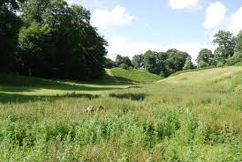
Health and the Environment
Dr Ellen Schwartz
Deputy Director of Public Health
Kent County Council

Slide 2
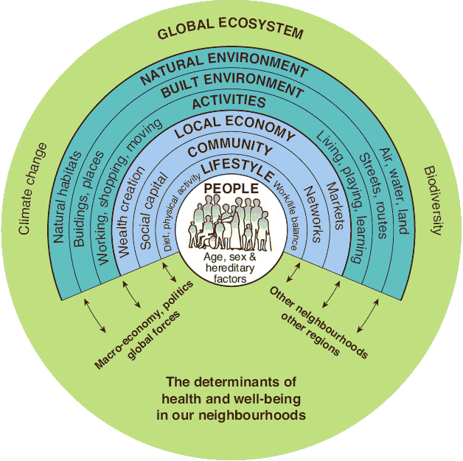
Notes:
Right now, people in our poorest neighbourhoods are dying a decade earlier than people in the wealthiest areas. When we don’t have what we need to heat our homes, buy healthy food and are constantly worrying about making ends meet, it can lead to chronic stress, poor health and lives being cut short.’

Slide 3
Building blocks for health
Education,
Skills
Surroundings
Money, resources
Work
Food
Family, friends, community
Housing

Slide 4
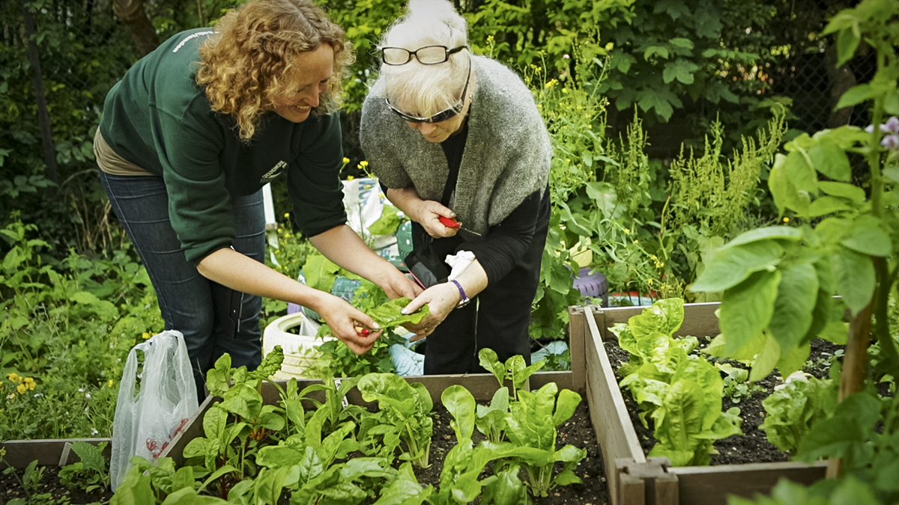
Green Social Prescribing
What are the benefits?
- Mental wellbeing, connecting with nature - Self-esteem, confidence and mood - Happiness, satisfaction and quality of life - Social connections, inclusion and sense of belonging - Skills, meaningful activity and personal achievement
- Preventing ill health in the first place
- Formal pathways for treatment and support
Recovery from physical and mental illness
Protecting the environment (biodiversity, tree planting)

Slide 5
Green Social Prescribing opportunities
Creating a partnership approach to health and green and blue spaces
Joining up with the ICB on prevention and reducing inequalities
Articulating the health benefits of the environment clearly
Mapping green and blue opportunities against areas and individuals who need it most and improving access
Creating opportunities along at all levels of prevention (before ill health starts, to alleviate ill health, during recovery)
Exploring ways to engage with and protect the environment
Creating and promoting good examples of practice

Slide 6
Examples of good practice
Everyday Active
Explore Kent #OutdoorsIsFree, #WinterWellbeingInKent
North Kent Countryside Partnership – Ecology Island
Northfleet Early Help – Horses for Health
Stepping out Tonbridge Therapy Garden

